Slide 1
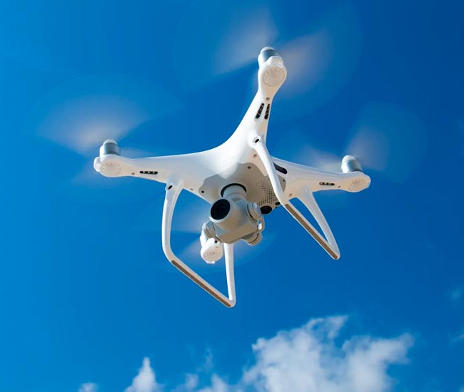

Surveillance Drone Cloud Platform - Communication
Harish Marepalli

Slide 2
Communication Protocol - Introduction
This presentation includes the basic communication protocol for drone surveillance.
The basic communication for any drone cloud includes registration, connectivity, reporting, and data transfer.
This communication involves the two-way handshake, which is a simple protocol to create a connection between two parties that want to communicate.
It is also considered as a signal between couple of devices or programs used to authenticate or coordinate.
Here, the communication is between client, server, database, and drone.

Slide 3
Communication Protocol - User
Client (User)
Server
Database
Drone
Calls the application URL
Serves UI Bundle
Register
User profile creation
Profile created
Registration Success
Register/Login
Screens
Login
Validates credentials
Login Success
Validation success
Dashboard
Fetches past bookings
Dashboard
Returns past bookings
List of past bookings
Chooses a drone and schedules it for a time frame.
Checks availability and billing details
Booking
Booking successful
Availability exists and booked
Triggers done for delivery
Request drone status updates
Stores in DB

Slide 4
Communication Protocol - Pilot
Client (Pilot)
Server
Database
Calls the application URL
Serves UI Bundle
Register
User profile creation
Profile created
Registration Success
Register/Login
Screens
Login
Validates credentials
Login Success
Validation success
Dashboard
Fetches current and past bookings
Dashboard
List of current and upcoming bookings
Returns current and past bookings

Slide 5
Communication Protocol - Pilot (Non- Autonomous)
Relational Database
Pilot (UI)
Drone
Server
Power ON (Enable)
Request to takeoff (Are you ready?)
Connect
Yes, Ready
Connected
Started
Predefined Mission Plan
Stores status
Status Tracking (Location, Battery Level)
Tracking
Stores status
Actions such as Video/Audio/Photo/IOT data
Big DB
Status Logs

Slide 6
Communication Protocol - Pilot (Non- Autonomous): Alerting and Response
Relational Database
Pilot (UI)
Drone
Server
Takeoff Command
Takeoff Ack
Detects, Classifies, and Alert Message
Crime, Emergency, …
Event Type, Location, Severity
Forward Alert
Alert Ack
Requests for Info
Alerting and Response
Info Response
Process Alert
Store Alert Data
Alert Process Ack
Notify DB
Status Updated
Alert Confirmation
Record Alert Data

Slide 7
Communication Protocol - Pilot (Autonomous)
Control Station
Relational Database
Drone
Server
Takeoff as per predefined schedule
Connect
Connected
Started
Predefined Mission Plan
Stores status
Status Tracking (Location, Battery Level)
Tracking
Stores status
Actions such as Video/Audio/Photo/IOT data
Big DB
Status Logs

Slide 8
Communication Protocol - Pilot (Autonomous): Alerting and Response
Control Station
Relational Database
Drone
Server
Takeoff Command
Takeoff Ack
Detects, Classifies, and Alert Message
Crime, Emergency, …
Event Type, Location, Severity
Forward Alert
Alert Ack
Requests for Info
Alerting and Response
Info Response
Process Alert
Store Alert Data
Alert Process Ack
Notify DB
Status Updated
Alert Confirmation
Record Alert Data

Slide 9
Communication Protocol - Pilot (Autonomous): Alerting and Response
Drone
Server
Takeoff Command
Takeoff Ack
Self-detect event
Alert {droneId, alertType, location, severity}
Classify Alert
Alerting and Response
Log Alert
Alert Acknowledgement
Detect emergency
Emergency Alert {droneId, emergencyType, location, severity, data}
Continued…

Slide 10
Communication Protocol - Pilot (Autonomous): Alerting and Response
Drone
Server
Classify Emergency
Log Emergency
Emergency Acknowledgement
Detect crime
Alerting and Response
Crime Alert {droneId, crimeType, location, severity, evidence}
Classify Crime
Log Crime
Crime Acknowledgement
Continued…

Slide 11
Communication Protocol - Pilot (Autonomous): Alerting and Response
Drone
Server
Custom Alert {droneId, alertType, location, severity, data}
Classify Custom Alert
Log Custom Alert
Alerting and Response
Custom Acknowledgement

Slide 12
Communication Message Request Diagram
REQUEST
REGISTRATION
CONNECTIVITY
MONITORING
ALERTING
REPORTING
RegisterDroneRequest
ConnectDroneRequest
StartMonitoringRequest
SendAlertRequest
SendReportRequest
GetRegistrationStatusRequest
DisconnectDroneRequest
StopMonitoringRequest
GetAlertStatusRequest
GetReportStatusRequest
GetConnectivityStatusRequest
CancelAlertRequest

Slide 13
Communication Message Response Diagram
RESPONSE
REGISTRATION
CONNECTIVITY
MONITORING
ALERTING
REPORTING
RegisterDroneResponse
ConnectDroneResponse
StartMonitoringResponse
SendAlertResponse
SendReportResponse
GetRegistrationStatusResponse
DisconnectDroneResponse
StopMonitoringResponse
GetAlertStatusResponse
GetReportStatusResponse
GetConnectivityStatusResponse
CancelAlertResponse

Slide 14
Communication Protocol - Related to Tracking
User Interface
Drone
Server
Database
Configurable settings (What to track and how frequently) (If no conf. settings, default settings are applied)
Sends all the tracking info
Location, Speed, Battery, etc are stored in DB
Tracking
Filters and sends back only the required information

Slide 15


Thank you
Harish Marepalli
harish.marepalli@sjsu.edu

